Slide 1
Deutsche Bahn
Delay Prediction
MACHINE LEARNING PROJECT
Hamburg
Hannover
Köln
Frankfurt
München
Sofija Šarafejeva

Slide 2



01 / OVERVIEW
Project Overview
Kaggle Database
Classification Objective
Balance
All trains passing through the Germany's 20 largest cities during:
2024-07-07 to 2024-09-06
Develop a model that predicts whether the train will have a delay
67% delays vs 31% on time
delay ≥ 1 min → has_delay: 1
Target column : has_delay (0 vs 1)
According to official 2024 DB reports, 67.4% of trains were classified as on-time, though this metric incorporates delays up to 15 minutes.
Notes:
Our project asks a simple question: can machine learning tell us which Deutsche Bahn train will be delayed before it even leaves the station?

Slide 3

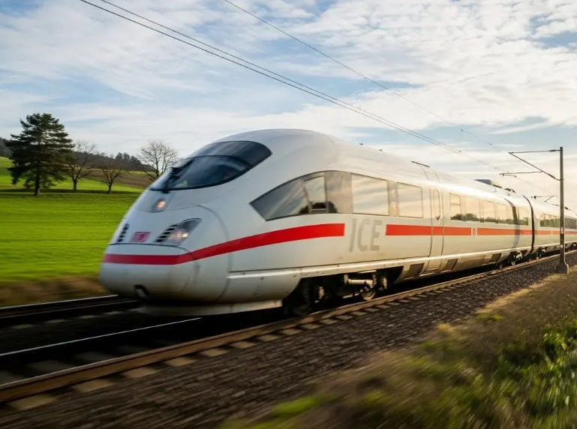
02 / DATA PREPARATION
Dataset Selection and Preparation
Cleanup
Filtered 77,146 logs down to 21,438 valid DB long-distance train types
Cancellation Segregation
Removed 2,042 outright cancellations into dedicated scope
Strict Leakage Shield
Dropped post-incident columns:
expected_time and real_time

Slide 4
03 / FEATURE ENGINEERING
Transforming Schedules Into Predictors
TEMPORAL
NETWORK
PIPELINE
Combined Datetime
Station Clustering
OneHotEncoder
Extracted hour, minute, day, and weekend indicators.
Grouped top 20 origins and 20 destinations.
Encoded all categorical features resulting in 50 standardized variables.

Slide 5
04 / DATA DISTRIBUTION
Target Asymmetry: 2:1 Delay Skew
67.2%
32.8%
4,288
Delayed Trips (2,881 Test)
On-Time Trips (1,407 Test)
Total Evaluation Set

Slide 6
04 / MODEL COMPARISON
4,288
Model Building and Evaluation
Total Evaluation Set
Algorithm Model | Test Accuracy | Precision | Recall
Random Forest | 76.33% | 78.46% | 89.27%
XGBoost | 73.51% | 74.79% | 91.36%
K-Nearest Neighbors (k=5) | 73.40% | 78.36% | 84.07%
Gradient Boosting | 72.04% | 73.03% | 92.57%
AdaBoost | 71.29% | 73.01% | 90.87%

Slide 7
05 / OPTIMIZATION
Model Optimization - Grid Search
Random Forest (Champion)
XGBoost (Runner-Up)
best parameters:
depth=20 | split=5 | leaf=1 | n=100
best parameters:
lr=0.25 | depth=8 | n=100
TEST ACCURACY
TEST RECALL
TEST PRECISION
TEST ACCURACY
TEST RECALL
TEST PRECISION
77.05%
90.42%
78.63%
76.17%
90.42%
78.63%

Slide 8
06 / ERROR DISTRIBUTION
Confusion Matrix: 2,605 Delays Caught
TRUE ON-TIME
FALSE ALARMS
699
708
90.4% Delay Capture Rate
Model captures 2,517 out of 2,881 test delays reliably.
MISSED DELAYS
TRUE DELAYS
Only 9.6% Unpredicted Delays
276
2,605
276 trips slip through without prior dispatch notice.

Slide 9
07 / ROADMAP
Future Work and Improvements
is model accuracy of 77% low ?
Weather analysis
Distance
Delay Reasons
Seasonality
Analyze total route distance kilometers to evaluate cascading delay risks on long-haul ICEs.
Classify specific failure modes (e.g., technical fault vs. track blockage) for targeted mitigation.
Map month-by-month patterns across winter/summer schedules to adjust baseline delay probabilities.
Ingest DWD storm, freeze, and wind warnings to predict environmental disruption.

Slide 10
10 / RETROSPECTIVE
Technical Bottlenecks & Solutions
CHALLENGE
CHALLENGE
Dirty Text & Route Cardinality
Class Imbalance Bias
Over 14,000 raw route strings contained ad-hoc delay remarks, disruption codes, and transit tags.
The natural 2:1 delay skew caused uncalibrated models to over-predict delay warnings.
Solution: Regex string extraction mapped 95% of traffic to Top 20 destinations.
Solution: Evaluated ROC-AUC (0.817) and shifted decision thresholds to 0.62.

Slide 11
11 / ROADMAP
Future Iterations & System Scaling
01
02
03
04
Weather Feeds
Live Delays
Regression
API Endpoint
Ingest DWD storm and freeze warnings.
Track upstream delay propagation across junctions.
Predict exact delay duration in minutes.
Deploy sub-millisecond scoring service via FastAPI.

Slide 12


Thank You for Your Attention

